Slide 1

Colt-X: The Use of AI for Network Automation and Network Optimization
Colt Technology Services
Berkeley Innovation X-Labs
Sutardja Center for Entrepreneurship & Technology
2021

Slide 2
Colt Technology Services
Who they are (telecommunications company)
What services they provide
Why we are doing this project: Challenges in the networking space
High-capacity networks are critical to support the growth of cloud and amount of data increasing exponentially.
Demand for bandwidth continues to grow rapidly across geographies
Access to a secure, high-capacity network is a must-have to meet customer needs

Slide 3

Scope: Network Automation and Optimization
(WHAT) Control graph network based on data we get from services to (WHY) provide information about performance through measurement and characterization of service-level agreement (SLA).
Description: Automatically adjusting certain elements of the network (look at data collected by probes) based on traffic conditions so more bandwidth can be added between locations. Can use data to make decisions about how to improve performance with delay of packet times. Parameters we want to control to enable quality of experience for certain applications: optimized bandwidth and delay.
Validation information: “We (Colt) need intelligence from data that tells us about degradation of services.” - Francesca Serravalle, Emerging Technology Director
Notes:
the problem
statistical multiplexing
measures of current qos, bandwidth, and the delay

Slide 4
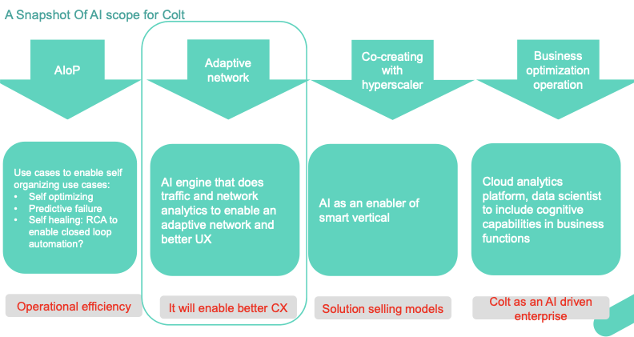
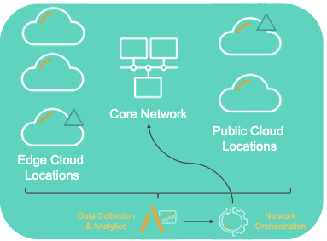
Scope: Dynamic SLA in AR/ VR Applications
(1) watch traffic
(2) tell characterization + pull what application is doing
(3) give number for bandwidth
Phase 1: take data from network and provide information about performance
automatically decide what to change to follow needs of traffic
Phase 2: measuring and characterizing dynamic service-level agreement (SLA) in AR/VR applications

Slide 5

Technical Components
Order of importance:
Python libraries: python, numpy, scipy, tensorflow, keras, etc.
Technologies: Apache Zeppelin, streamlit, git
DEMO with analytics partner (Accedian): real time effect of changing bandwidth performance in test environment
What information is easy to get as an input (available data), can put probes in network (application server) to get data from server
UI component: what information will be displayed that is valuable for Colt
Algorithmic prototyping and mathematical computations. Resource: Ikhlaq
Green & Orange: Easy to develop
Red: To learn

Slide 6














System Architecture: Colt Application-Centric Network
Skylight Performance Analytics (Accedian)
Real-time Effect of Changing Bandwidth
Data extraction
COLT Novitas Portal: On-Demand Live Portal
(Bandwidth changes)
https://ondemand.colt.net
Algorithm Prototyping:
Optimized bandwidth
Dynamic SLA Mathematical Computations
Stats including mean, variance, etc.
Statistical Multiplexing (see application)
Storage:
short: Apache Zeppelin (Python/ R)
long: .csv files
INPUT: Network traffic data collected from probes placed against AR/VR applications
Log event data
OUTPUT: New settings (Bandwidth)
Graph of network and measures of current Quality of Service (QOS)
Network delays experienced on link
Display the Measurement and Characterization of Dynamic Service-Learning SLA
Phase 1&2 PROCESSES
Feedback from Colt

Slide 7
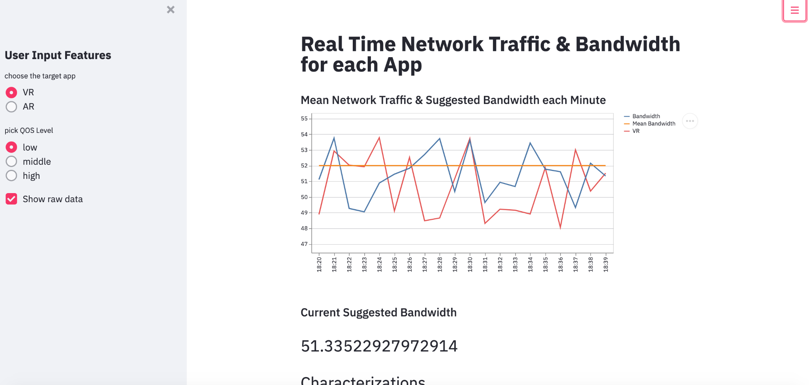
User (Colt) Perspective

Slide 8
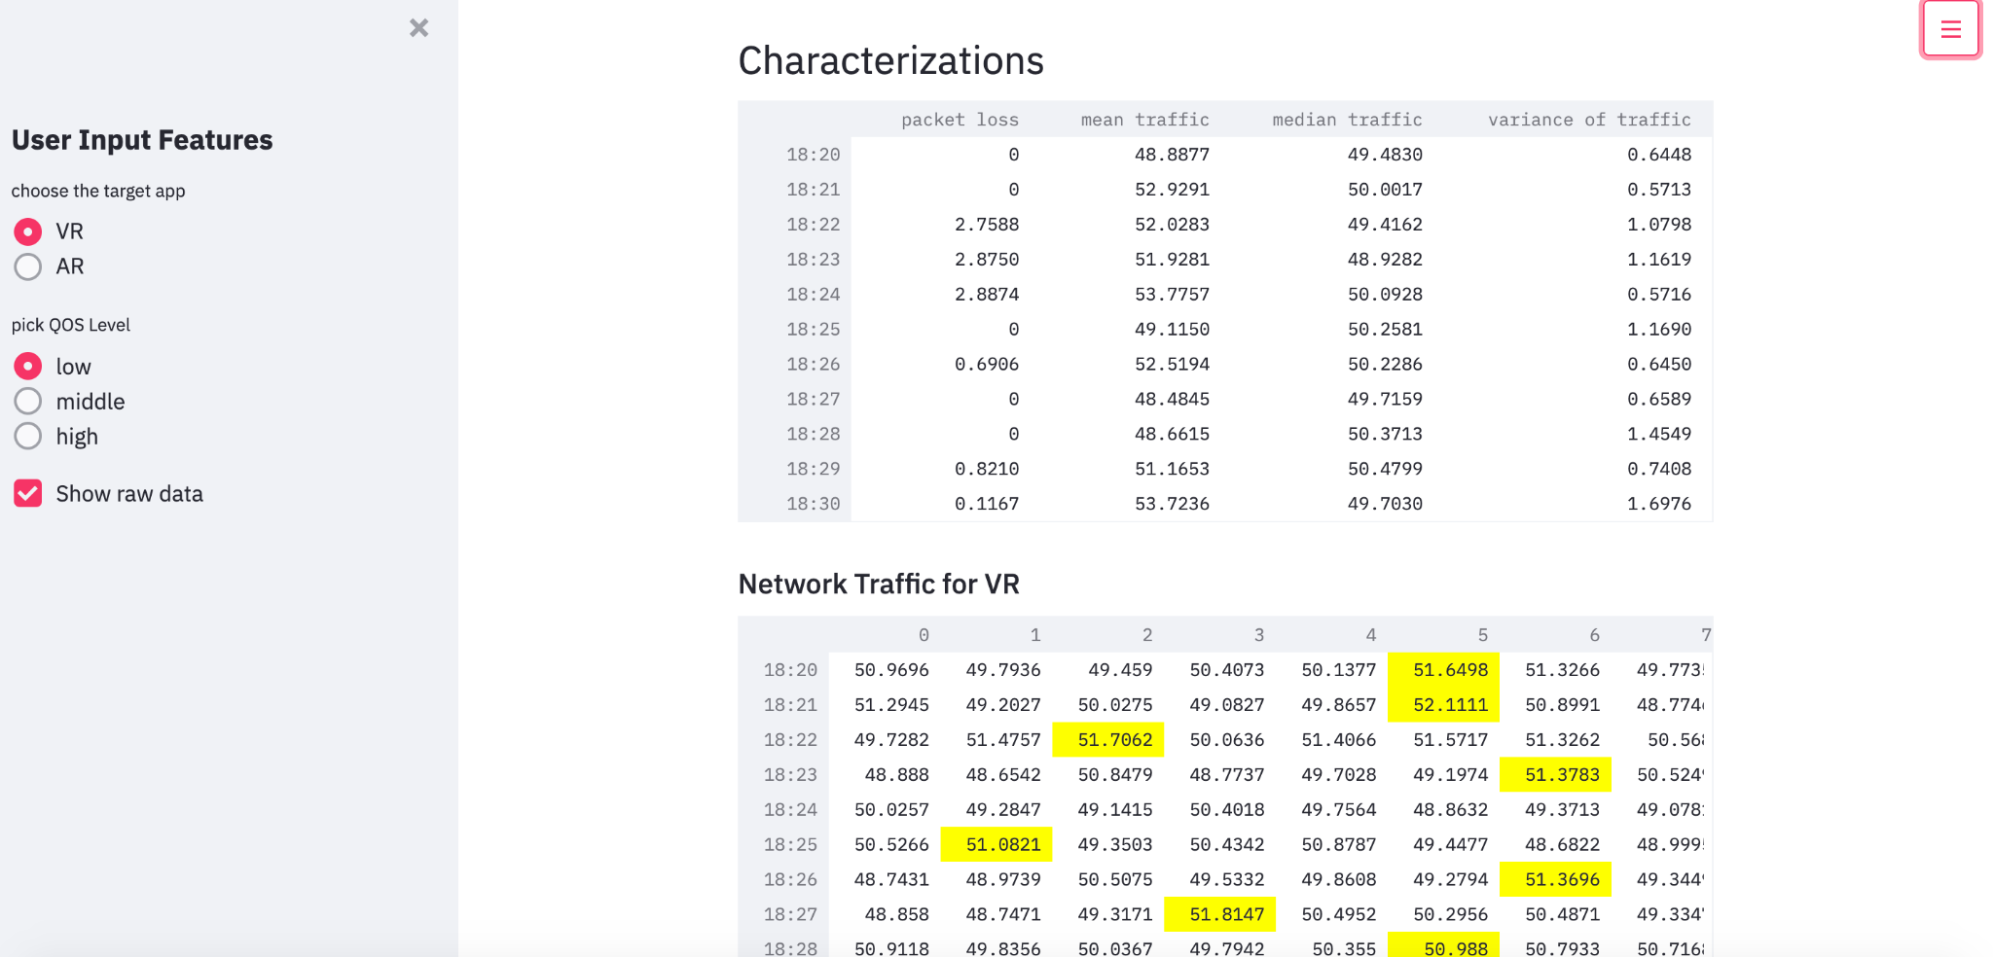
User (Colt) Perspective

Slide 9
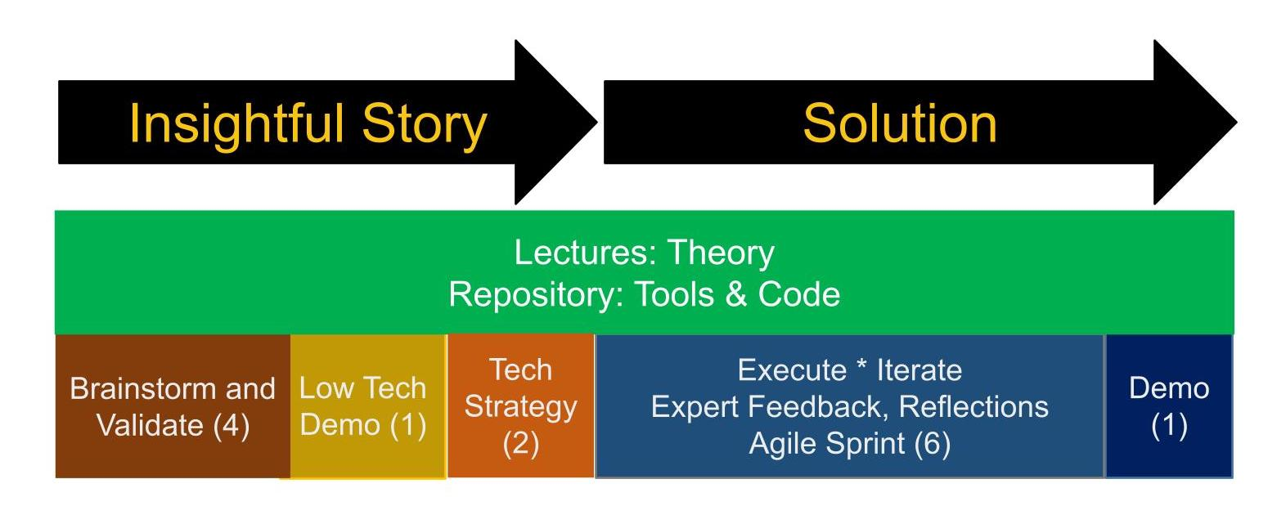
Project Timeline
Next Steps
Brainstorm/Project Story with Colt Mentor (Week 1)
Low Tech Demo v1 (Week 2)
Low Tech Demo v2 (Week 3)
Technology Strategy (Week 4)
Low Tech Demo complete with tech strategy v3 (Week 5)
Execution in 4 Weekly Sprints Weeks (6-10)
Demo, Presentation, and scope of next project - v1 Week 11
Final Demo, Presentation, and scope of next project Week 12

Slide 10




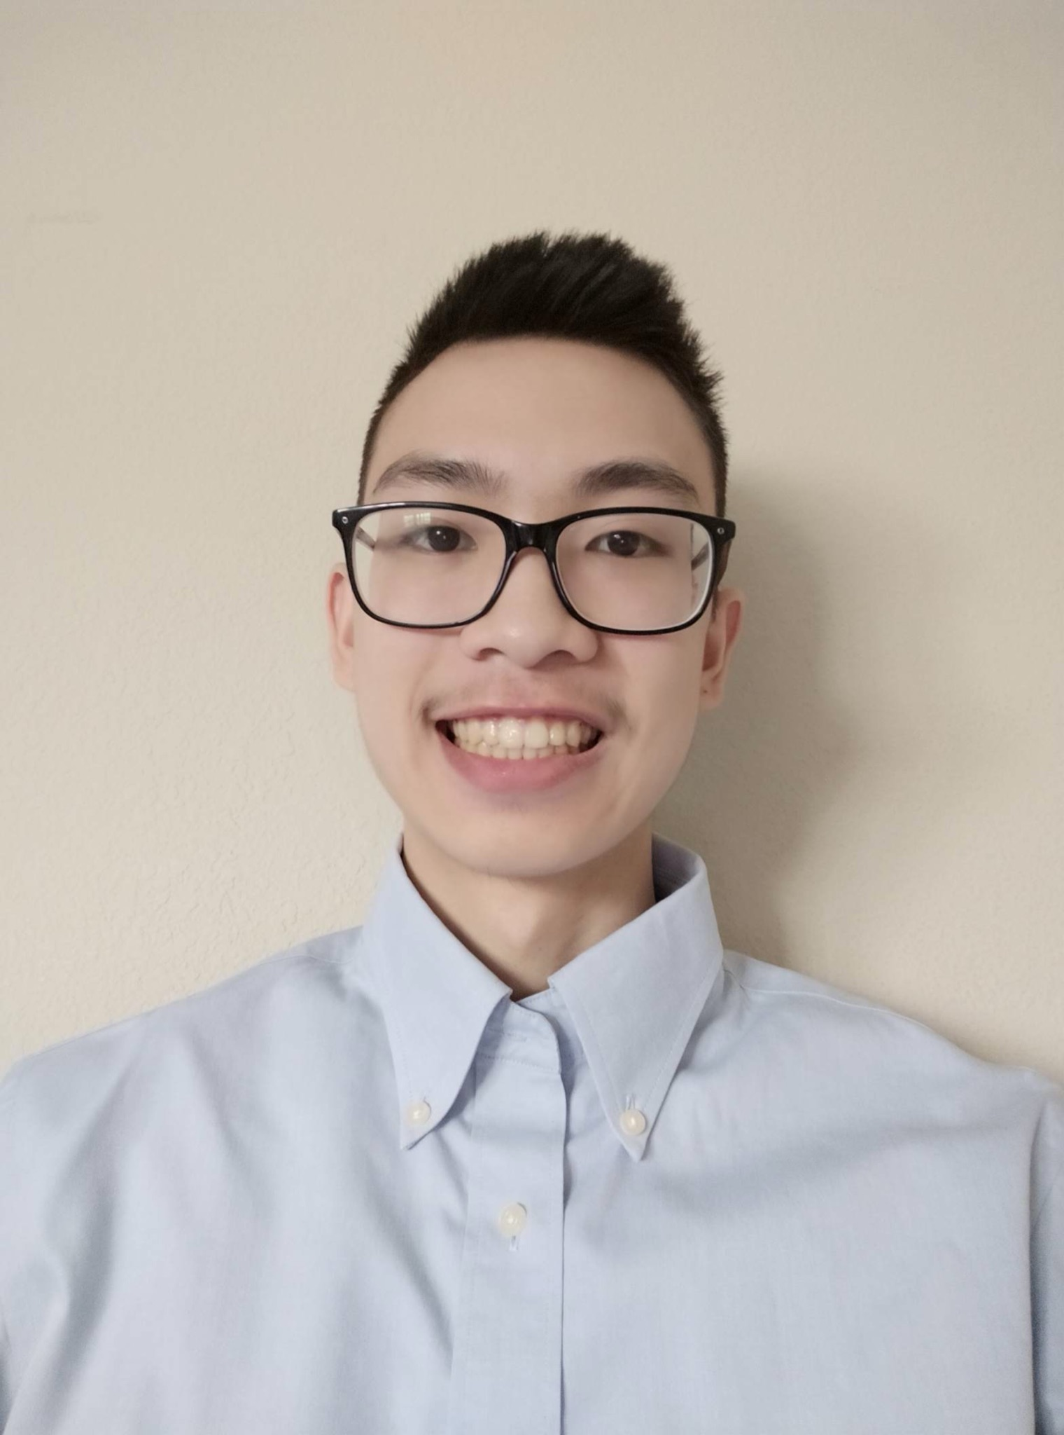

Meet the Innovation-X Team
Isabel Zavian
Management Lead
B.A. Economics & Data Science
izavian@berkeley.edu
Noor-Ul-Ain Ali
Technical Lead
B.A. Data Science
noorulain@berkeley.edu
Ronel Solomon
Technical Member
B.A. Data Science
ronelsolomon@berkeley.edu
Charline Shen
Intern
B.A. Computer Science & Physics
tingweishen@berkeley.edu
Andy Lam
Intern
B.S. Mechanical Engineering
alam9414@berkeley.edu
Peter Li
Intern
B.A. Applied Math & Computer Science
lixingyu@berkeley.edu

